Slide 1
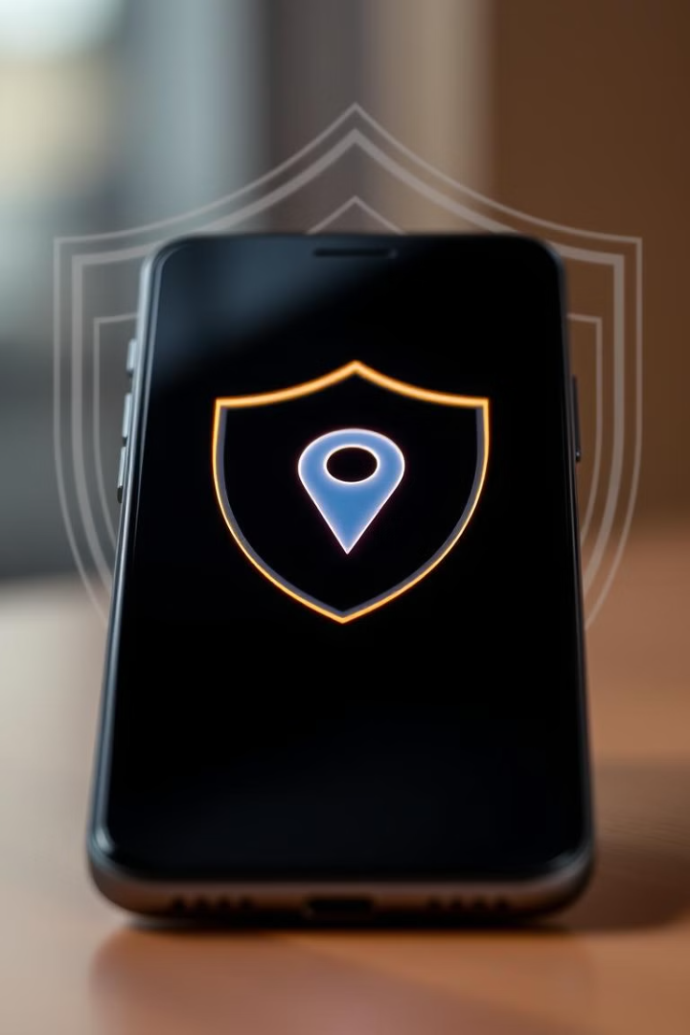

Anti-Theft Mobile Tracker– Locates Lost and Stolen Devices
Submitted By
A kalyan Kumar (192111676)

Slide 2
Addressing the Need for Mobile Security
Data Loss Prevention
Real-Time Updates
Remote Access
Losing a smartphone can lead to significant data loss and privacy concerns. This project aims to develop a mobile tracking system that helps users locate their lost or stolen devices efficiently, mitigating potential data breaches.
The system provides real-time updates on a device’s location using GPS and network-based tracking. This ensures users can quickly pinpoint the whereabouts of their device, enhancing the chances of recovery.
Remote locking and alert notifications are integrated to provide users with control over their device, even when it's out of reach. This adds an extra layer of security, preventing unauthorized access.

Slide 3
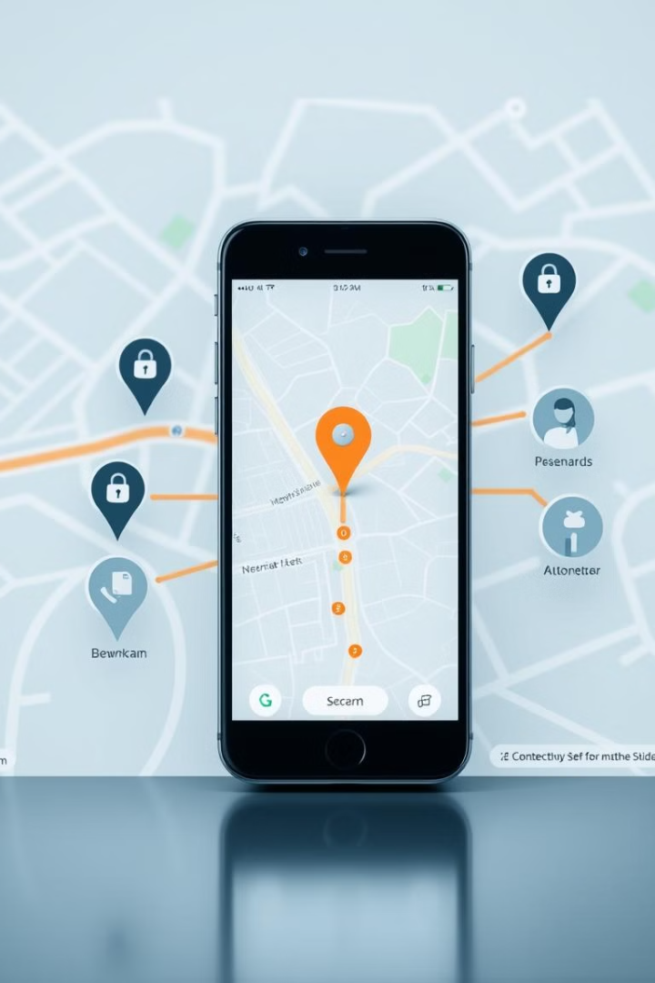
Project Objectives and Significance
1
System Development
Location Retrieval
2
Design and implement a mobile tracking system that utilizes GPS, network-based tracking, and remote access functionalities.
Develop algorithms to pinpoint the device’s real-time location and display it on a map.
3
Security Features
Integrate security options such as remote locking, alarm triggering, and data protection.

Slide 4

Problem Identification and Analysis
Financial & Data Loss
Inaccurate Data
Rising Theft
Losing a mobile phone can result in significant financial and data loss, along with security risks. Traditional methods may be costly or lack strong security measures.
Some tracking systems fail to provide accurate real-time location data or lack security features such as remote locking and data protection.
Reports from cybersecurity agencies indicate a rise in smartphone thefts, with millions of devices lost or stolen annually, emphasizing the need for robust tracking solutions.

Slide 5
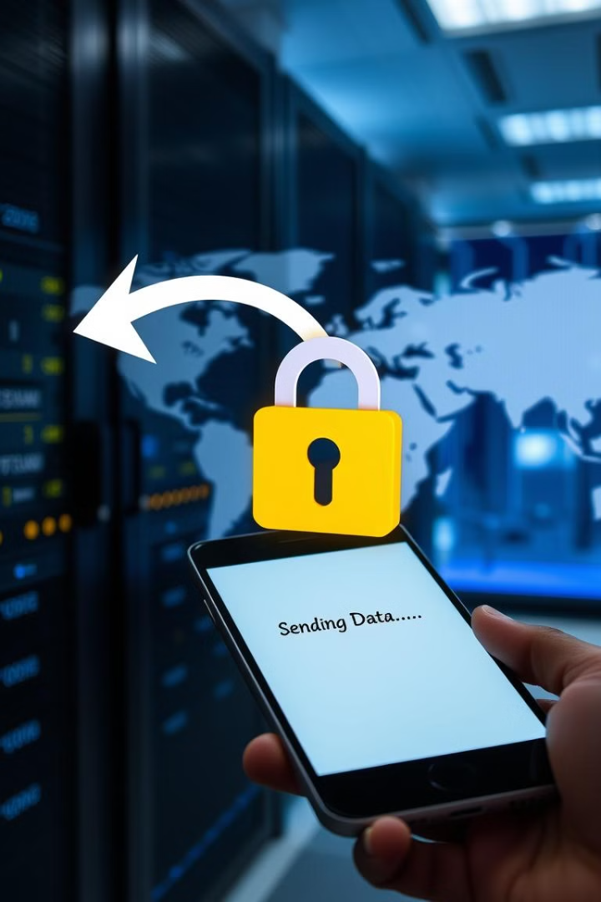

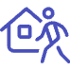

Solution Design and Implementation
GPS Tracking
Remote Commands
User Authentication
Continuously monitors the phone’s location for real-time updates.
Allows users to lock, wipe, or sound an alarm on the lost device remotely.
Ensures only authorized users can access tracking features, enhancing security.

Slide 6

Development and Design Process
1
Initial Research
Analyzed existing tracking solutions and their limitations to identify gaps and opportunities.
2
Requirement Gathering
Defined key features like real-time tracking, remote access, and security measures based on user needs.
3
System Design
Developed architecture with GPS tracking, remote commands, and user authentication protocols.
4
Prototype Development
Built an initial version using Python, testing location accuracy and security features rigorously.

Slide 7
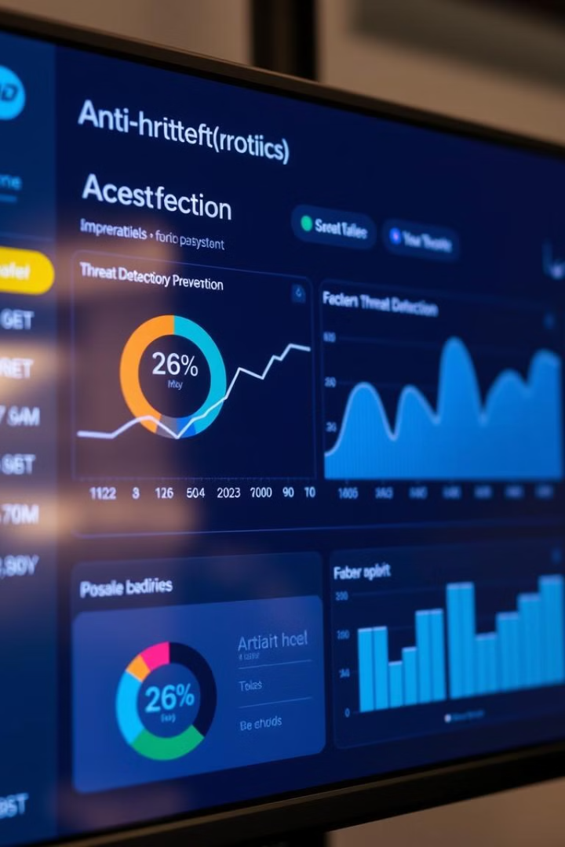
Results and Recommendations
90-95%
1-2s
Location Accuracy
Response Time
Achieved in urban areas, integrating Wi-Fi-based tracking to mitigate GPS interference.
Remote commands executed within this timeframe on average, ensuring quick action.
85%
User Satisfaction
Testers rated usability as "excellent," indicating a user-friendly design.

Slide 8
Possible Improvements and Future Enhancements
AI-Based Theft Detection
1
Use machine learning to detect unusual device behavior patterns.
Multi-Platform Support
2
Expand compatibility to include iOS devices for broader accessibility.
Biometric Authentication
3
Enhance security with fingerprint or facial recognition technology.

Slide 9
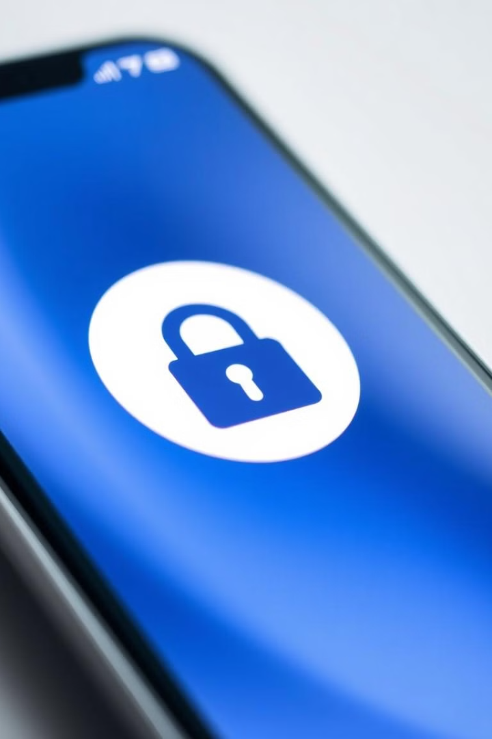
Conclusion
This project created a mobile tracking system using Python. 1 It helps find lost or stolen phones with accurate location tracking, remote security features, and privacy protection. 1 The system is designed to be a good, affordable option for mobile security.

Slide 10



